Slide 1
Title of the project: Flight Price Prediction Project

Slide 2
PROBLEM STATEMENT AND UNDERSTANDING
Anyone who has booked a flight ticket knows how unexpectedly the prices vary. The cheapest available ticket on a given flight gets more and less expensive over time.
This usually happens as an attempt to maximize revenue based on –
1. Time of purchase patterns (making sure last-minute purchases are expensive)
2. Keeping the flight as full as they want it (raising prices on a flight which is filling up in order to reduce sales and hold back inventory for those expensive last-minute expensive purchases)

Slide 3
EDA STEPS AND VISUALIZATIONS
This involves generating summary statistics for numerical data in the dataset.
Creating various graphical representations to understand the data better.
We have performed initial investigation of data so as to discover patterns, to spot anomalies, to test hypothesis and to check assumptions and to find the correlation with the help of summary statistics and graphical representation.

Slide 4
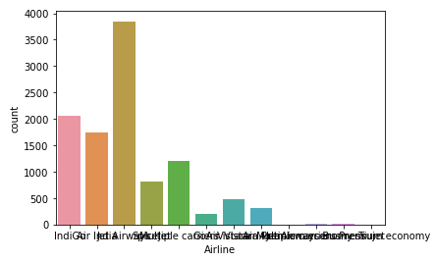
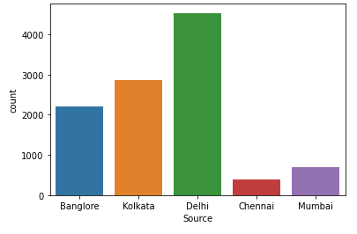
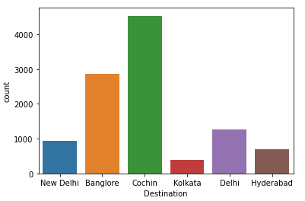
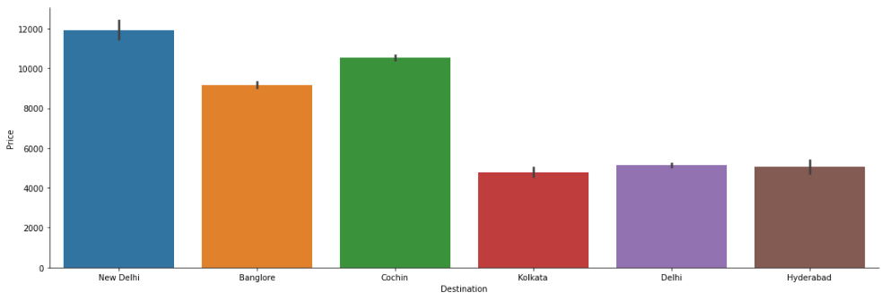
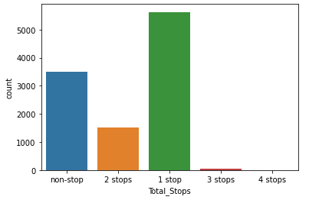
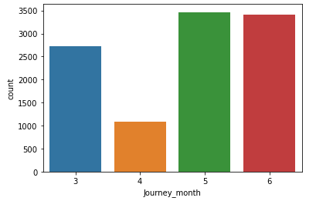

Slide 5
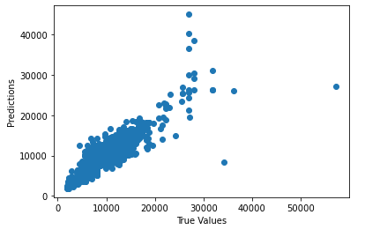
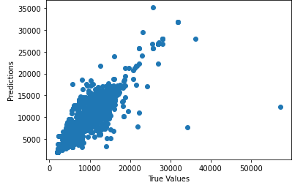
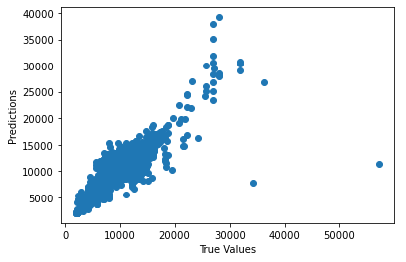
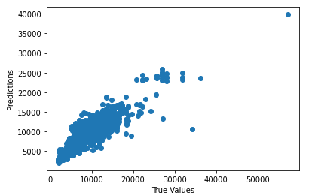

Slide 6
STEPS AND ASSUMPTIONS
In this project we have not assumed anything and since the data is collected using webscraping it has some missing values which we have handled.
After that, we splitted the data into training and testing set. We trained the model using four classification algorithms namely XGBoost Regression, Decision Tree Regression, Gradient Boosting Regression and Random Forest Regression And used hyperparameter tuning and created a scatter plot for predicted and actual prices which was shown in the above slide.

Slide 7
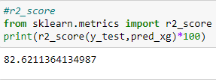
Finalized Model
Out of four classification models XGBoosting Regressor is giving the more R squared value with improved cross validation score. So we have finalized this model as the best fit for our dataset.
Thus we evaluated the model and plotted the graph for predicted and actual prices.

Slide 8
Conclusion
There is no definitive guide of which algorithms to use given any situation. What may work on some data sets may not necessarily work on others. Therefore, always evaluate methods using cross validation to get a reliable estimate.
Sometimes we may be willing to give up some improvement to the model if that would increase the complexity much more than the percentage change in the improvement to the evaluation metrics.
In some regression problems, r2_score may be less because of the data that have and we cannot judge this by only seeing a r2_score we should use some analytical techniques to find the best.
Missing values sometimes add more information to the model than we might expect. One way of capturing is to add.

Slide 9


